Slide 1
Fast Radio Burst search algorithm
Chenhui Niu
Graduate Student from
NAOC & Central China Normal University
CASPER Workshop 2017
Caltech ,Pasadena

Slide 2
What’s FRB?

Slide 3
FRB , Fast Radio Burst is a high energy physical phenomenon happened in our universe.
Happened suddenly
High Energy
Notes:
The first FRB are found by Lorimer in 2007 from pulsar archive data.

Slide 4
How do we detect FRB?

Slide 5
Property of FRB
Dispersion
Scatter
Scintillation
Notes:
To deteck FRB ,we should know the property of FRB first. Actually Not only FRB , Al the transient which happened in our universe have this 3 basic property. Dispersion , Scatter, and scintillation. All the phenomenon are caused when the signal go cross the Interstellar or intergalactic medium.

Slide 6
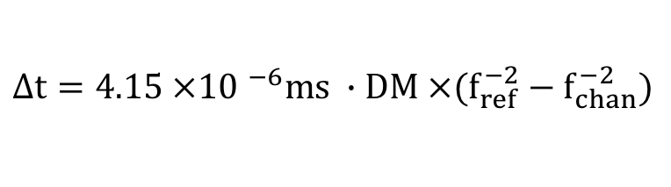
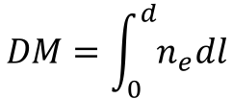
dispersion
$$∆t={4.15 ×10 }^{−6}ms ∙DM ×(f_{ref}^{−2}−f_{chan}^{−2})$$
Dispersion Measure:
$$DM=\int_{0}^{d}{n_{e}dl}$$
Notes:
Interstellar or intergalactic medium is a cold ,ionized plasma. Electromagnetic radiation from source will experience a frequency-dependent index of refraction as they propagate through the plasma. The high frequency part of signal will go through faster than lower frequency.(It’s pretty like the rainbow principle. When light go cross the atmosphere , different frequency will be fraction diffidently.) So there will be a time delay when we observe the different frequency of signal . As this is caused by signal go cross Interstellar or intergalactic medium, this delay should have a relationship with how much Interstellar medium they gone through. The more medium they gone through , the higher time Delay we have. Here we should define a parameter Dispersion Measure. It equal $DM=\int_{0}^{d}{n_{e}dl}$. Ne is the electron number density, d is the distance form observe. So if ne is a constant, the DM should stand how far the signal is. if we have larger DM value ,We will meet a high dispersion.
I gonna jump the complex deduction of time delay equation ,The time delay between 2 frequencies is:$∆t={4.15 ×10 }^{−6}ms ∙DM ×\left(f_{ref}^{−2}−f_{chan}^{−2}\right).$If we plot spectrum varied with time, we will see a curve. Then using this property we can divide from RFI and our true signal.
DM is how much electronics we have

Slide 7
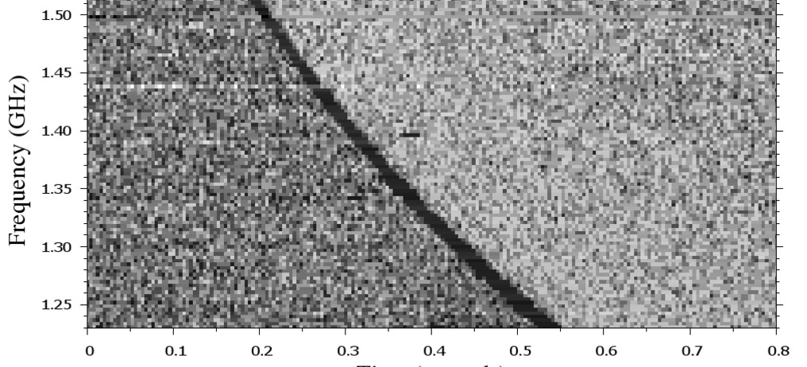
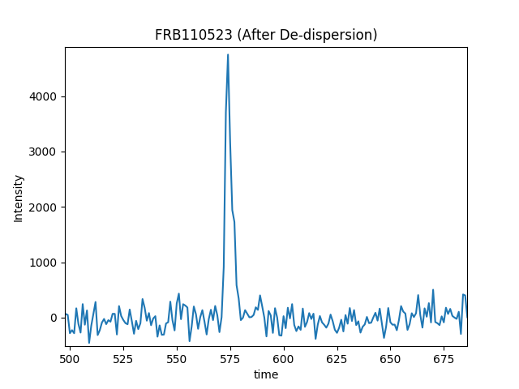
Scatter
source
ISM
1
object
2
Antenna
Notes:
Scatter is when same signal transit to all direction and go cross intermedium. then the other direction hit some object then came back to our telescope. So the signal from same source we will receive twice. So we got a tail in the observing. The picture is the real data from FRB110523, we can see a tail obviously. As the low frequency will go slower than high frequency ,and the other unexpect direction signal will suffer a longer path. So in Frequency –time plot, we often see the low frequency signal width is bigger than high frequency. This is why it’s difficult to find FRB from low frequency.

Slide 8
Scintillation
source
ISM
1
object
2
Antenna
Notes:
Scintillation is similar mechanism. The signal which are from other direction might get scatter , but the direction from source might go through a different ISM , or a cloud of plasma. Then the two signal some frequency might arrive almost simultaneously to our antenna . If it satisfied interference . This will appear a scintillation , like the picture on the right.

Slide 9
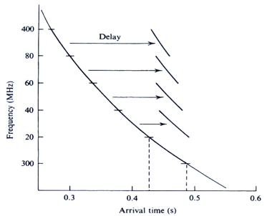
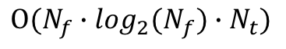
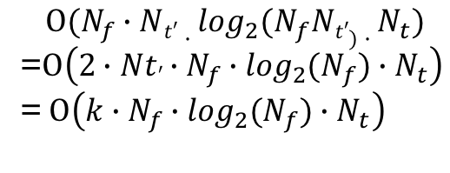
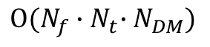
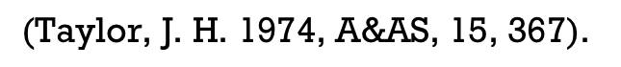
Trends for Pulse search algorithms
$$Ο(N_{f}{∙N}_{t}∙N_{DM})$$
$$Ο(N_{f}{∙{\log_{2}(N}_{f})∙N}_{t})$$
Time shift
Tree Algorithm
Machine learning
Image Processing
$$\text{(}\text{Taylor}\text{, }\text{J}\text{. }\text{H}\text{. 1974, }\text{A}\text{\&}\text{AS}\text{, 15, 367). }$$
$$Ο(N_{f}{∙Nt′∙{\log_{2}(N}_{f}Nt′)∙N}_{t})$$
=$Ο\left(2{∙Nt′{∙N_{f}∙\log_{2}(N}_{f})∙N}_{t}\right)$
= $Ο\left({{{k∙N}_{f}∙\log_{2}(N}_{f})∙N}_{t}\right)$
Notes:
Nowadays There are lots of FRB searching algorithms. But we can summarize these methods into 4 directions. Time shift , Tree algorithm ,Image processing and Machine learning . The Machine Learning is a pretty new trend, I just heard some one is working on it , but not quite know what’s exact is, So today I gonna not to talking about.
Time samples shift is the most directly way that people can came up with. As we talked before the signal after propagate through interstellar media has the dispersion character. If we want to get the original signal ,we only need shift the time sample back. As each time sample should shift at exact time delay according 1 DM value. Then we need also sum along whole frequencies.(explan figure.) If we have Ndm to de-disperse, So the compute complexity is $Ο\left(N_{f}{∙N}_{t}∙N_{DM}\right). \text{T}\text{his} \text{is} \text{the} \text{much} \text{more} \text{time} \text{consuming}\text{. }\text{However} \text{it} \text{has} \text{a} \text{good} \text{character} \text{to} \text{paraller} \text{process}\text{. }\text{Assume} \text{we} \text{have} \text{lots} \text{of} \text{CPUs}\text{ , }\text{we} \text{can} \text{devide} \text{data} \text{from} \text{time} \text{axis} \text{or} \text{DM} \text{directions}\text{ . }\text{What}’\text{s} \text{more}\text{ ,}\text{if} \text{we} \text{using} \text{GPU} \text{units} \text{instead}\text{, }\text{the} \text{brute} \text{force} \text{will} \text{give} \text{a} \text{obviously} \text{speed} \text{up}\text{. }\text{Actually} \text{that}’s \text{what} \text{Heimdall} \text{does} \text{at} \text{present}\text{. }\text{Heimdall} \text{is} \text{a} \text{well}\text{−}\text{developed} \text{software} \text{to} \text{FRB} \text{search}\text{.}$
In 1974, $\text{Taylor} \text{developed} \text{an} \text{algorithm} \text{called} \text{Tree} \text{Algorithm}\text{(}\text{Taylor}\text{, }\text{J}\text{. }\text{H}\text{. 1974, }\text{A}\text{\&}\text{AS}\text{, 15, 367), }\text{which} \text{chould} \text{reduce} \text{the} \text{compute} \text{complexity} \text{to} Ο(N_{f}{∙{\log_{2}(N}_{f})∙N}_{t})$.He $\text{find} \text{there} \text{are} \text{a} \text{lot} \text{of} \text{re}\text{−}\text{used} \text{source} \text{available} \text{when} \text{doing} \text{time} \text{shift} \text{de}\text{−}\text{dispersion}\text{.}$ $\text{If} \text{we} \text{re}\text{−}\text{use} \text{the} \text{summation} \text{of} \text{former} \text{elements}\text{ , }\text{the} \text{compute} \text{intensity} \text{will} \text{decrease} \text{a} \text{lot}$.
Our group also try to using Image process method to search FRB, Someone is using Radon transform to search curve directly from freuquency-time map. Some is trying to find a signal after some fore-processing. I will introduce my algorithm latter.

Slide 10
How does Tree Algorithm accelerate?
Notes:
First ,let’s talk a little bit about Tree algorithm , How does tree algorithm accelerate?

Slide 11
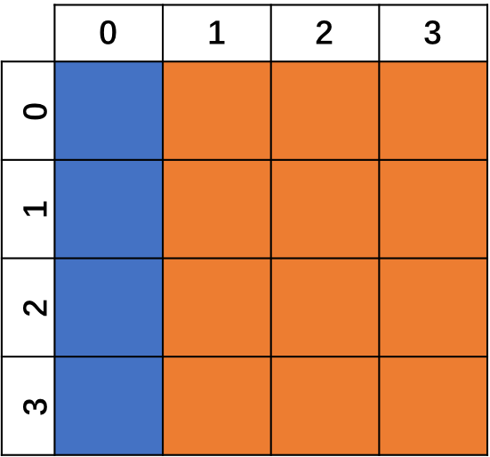
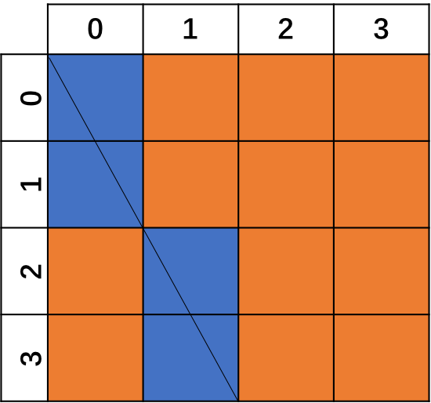
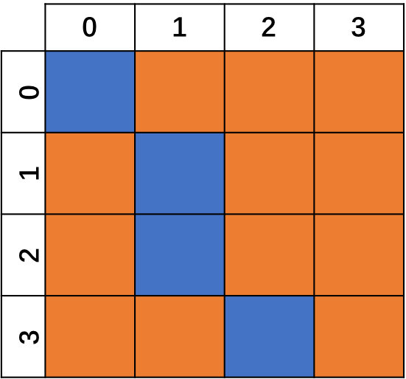
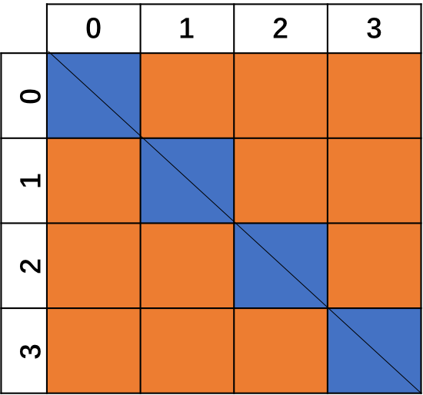
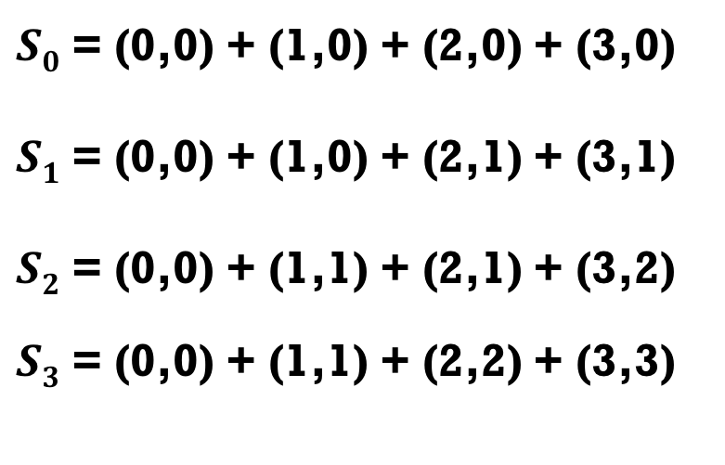
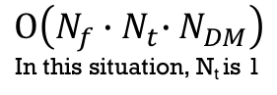
$S0$ = (0,0) + (1,0) + (2,0) + (3,0)
$S1$ = (0,0) + (1,0) + (2,1) + (3,1)
$S2$ = (0,0) + (1,1) + (2,1) + (3,2)
$S3$ = (0,0) + (1,1) + (2,2) + (3,3)
Time Delay = 0
Time Delay = 1
$$Ο\left(N_{f}{∙N}_{t}∙N_{DM}\right)$$
In this situation, N_{t} is 1
Time Delay = 2
Time Delay = 3
Notes:
For easy start, we assume an array with shape(4,4).When we calculate DM dispersion , it’s like summation the pixel which are along the line. Here we approximate the real curve signal into straight line because we have a tiny data array. Blue block means where signal go through. The top 1 left is the situation at DM = 0, In this situation , the time delay between different frequency channel is equal 0. The other maps are the signal at different DM value. From the map we can easily tell what the signal value is at exact DM value. Same as we got compute complexity before, we can count here ,the operation here will be 16.(Nt is the time for start sample, and this situation ,the start time is 0)

Slide 12
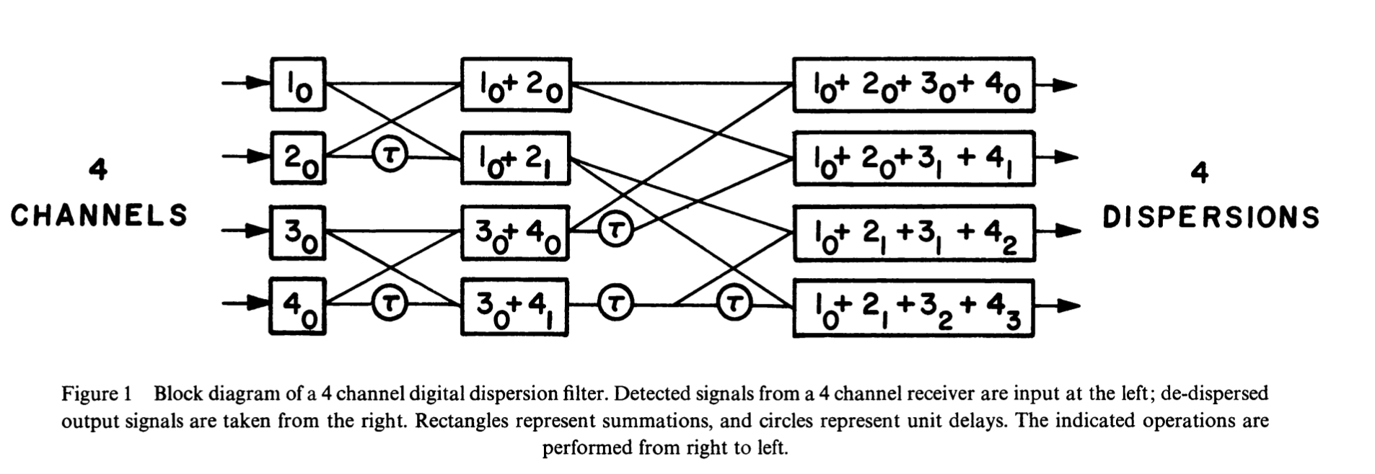
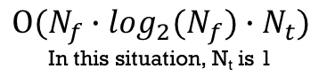
Time Delay = 0
Time Delay = 1
$$Ο(N_{f}{∙{\log_{2}(N}_{f})∙N}_{t})$$
In this situation, N_{t} is 1
FDMT
Barak Zackay , [ The Astrophysical Journal, 835:11 (13pp), 2017 January 20 ]
Time Delay = 2
Time Delay = 3
Notes:
Taylor found a algorithm that also could get the same result, it’s like a tree , so he called the tree algorithm. Sum 1 pair inputs through some butterfly Then re-combine and re-use the sum that already got could get the final result with exact time delay. It’s pretty like Fast Fourier Transform butterfly algorithm. The compute complexity is got $Ο(N_{f}{∙{\log_{2}(N}_{f})∙N}_{t})$. In this situation , Nt is 1, because we only search signal start from time 0
And we can also count from algorithm, there are 8 sumation. There are a lot of improved tree algorithm. The most popular direction is to use subband method ,as tree algorithm is calculate the straight line ,if we want approximately curve, the best way is calculate through sub-band. There are a lot of people doing this , FDMT developed by Barack is one that may get the best SNR now. It calculate time delay dynamically. I didn’t remember much details , you could read his paper for know more about it.

Slide 13
Introduction to a new idea to Search Fast Radio burst
2 Dimensional FFT Algorithm!
Collaborator : Ue-li Peng, Xuelei Chen, Yichao Li, Jayanth Chennamangaiam, Dan Werthimer,
Jack Hickish, Casey law, Vishalkumar Rasiklal Gajjar,
Greg Hellbourg etc.
Notes:
Today I want to introduce a new idea to search FRB. 2 dimensional FFT algorithm! This Algorithm come up with by Ue-Li Peng from CHIME. We also have a lot of collaborators, like Xuelei, Yichao, Jayanth. Dan ,Jack , Casey ,Vishal, greg and so on. This algorithm is kind of image processing. We want search signal line directly from the map processing.

Slide 14
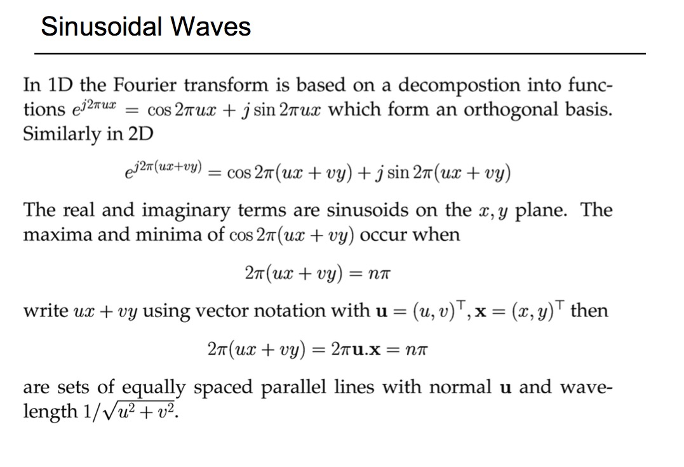
Brief Review : Properties of 2D FFT
Notes:
Before talking about the algorithm , I‘d like to have a brief review for some useful properties of 2 dimensional Fast Fourier transform.

Slide 15
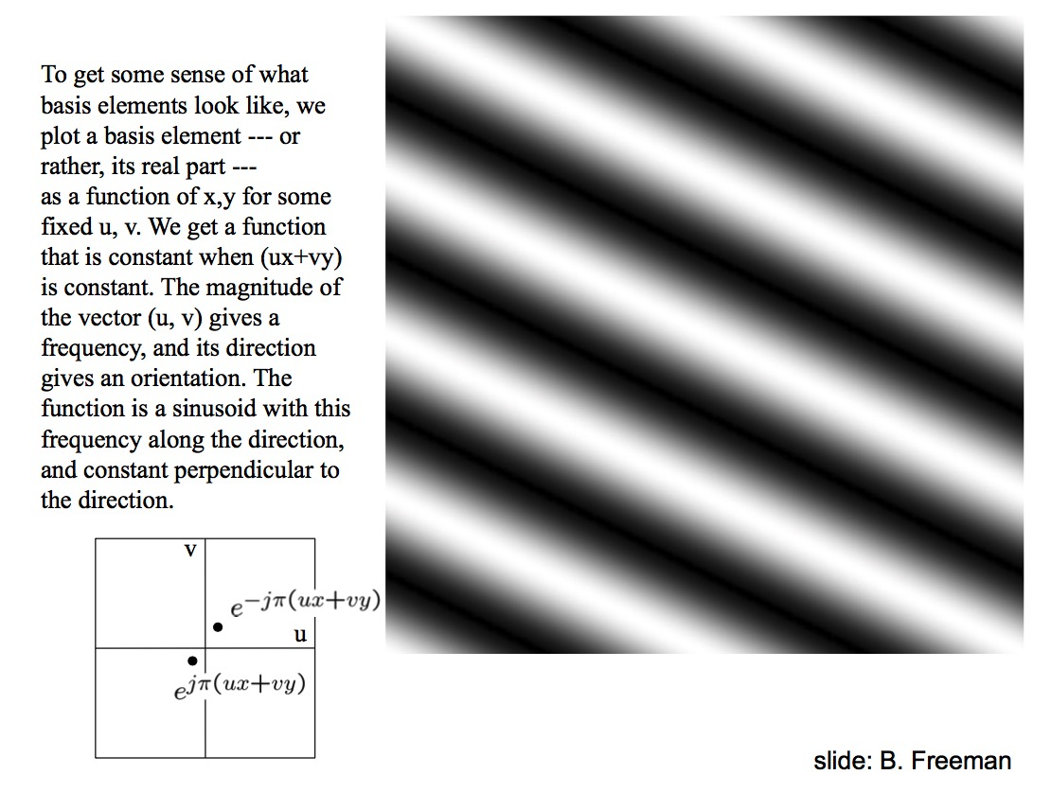

Slide 16
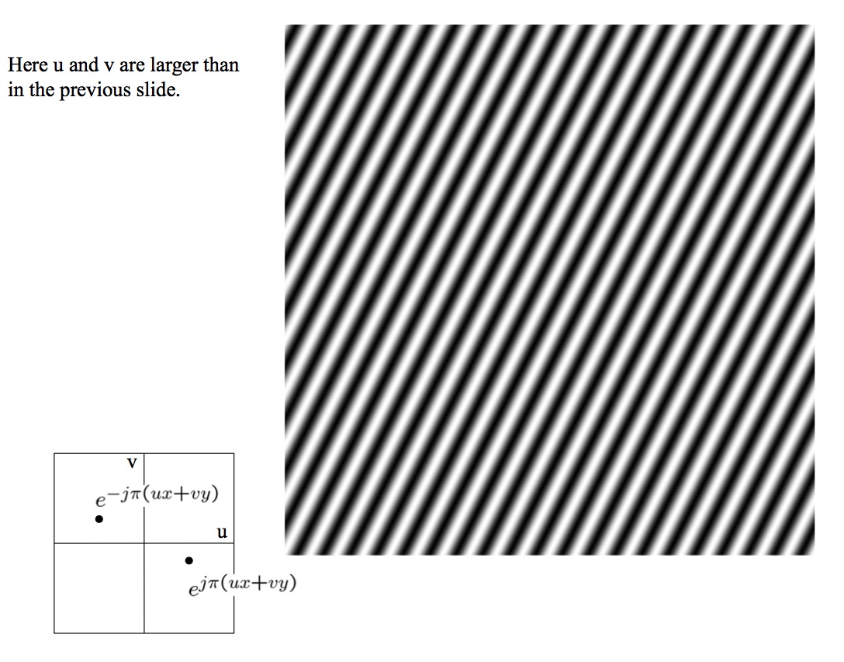
Notes:
As we know , The large scale after FFT will become the small scale. So if the (x,y) map has a higher frequency , at the frequency domain will have a bigger (u,v) value.

Slide 17
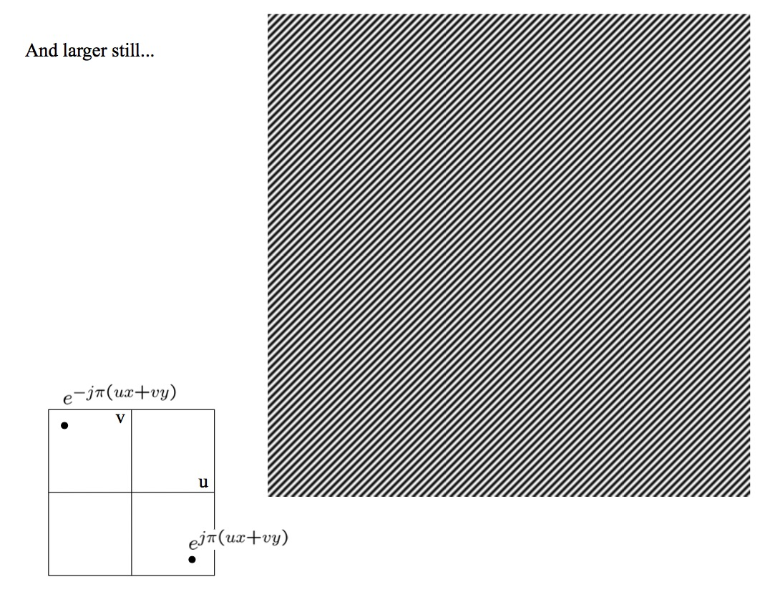

Slide 18
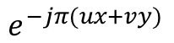
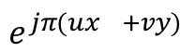
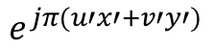
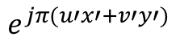
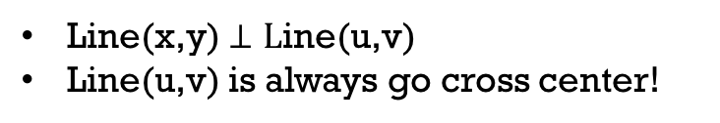
(x , y )
(x’ ,y’)
$$e^{−jπ(ux+vy)}$$
v
$$e^{jπ(u′x′+v′y′)}$$
u
$$e^{jπ(u′x′+v′y′)}$$
$$e^{jπ(ux^{}+vy)}$$
Line(x,y) $⊥L$ine(u,v)
Line(u,v) is always go cross center!
Notes:
So , assume we have line in (x,y) map, this line has a width. The boundary of the line width is the max limit length in (u,v) plane. Like illustrate above, If we denote (x,y) as the points on boundary line. (x prime,y prime) are points on dashed line which are inner boundary for easy compare. If we do 2D FFT on this map. The (x,y) point will become further than the (x’,y’). That’s because the small scale decide the large scale on the other domain. If we consider the lines inside the widen line. As they are continuous, so in (u,v) map , it will appear a short straight line who’s length are constrained by boundary of (x,y) space. Same method ,we can get the width of line after 2DFFT. Generalize, when we do a straight line in the original map , in the 2-D FFT map ,frequency map, it will become perpendicular to original one . what’s more , it will go cross center no matter the original one is or not. We can use this method to search a straight line.

Slide 19
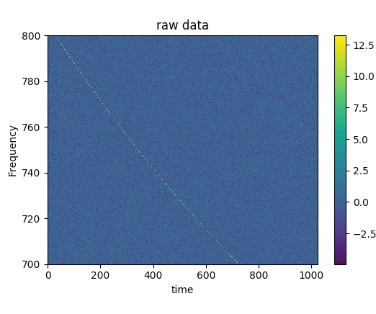
Using 2d-fft search a line !
Rebin
2D-FFT
Polar coordinates transform
Find signal

Slide 20
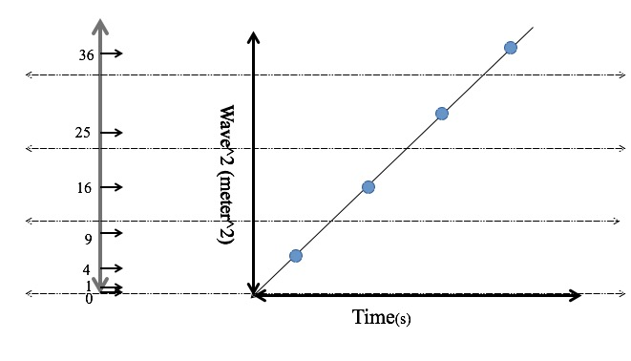
Re-bin:
$$∆t={4.15 ×10 }^{−6}ms ∙DM ×(f_{ref}^{−2}−f_{chan}^{−2})$$
Notes:
As 2D-FFT is good at straight line process, it will become more complex if it’s a curve. But our signal’s frequency and time has a relationship t-f^-2. So first step we want to do is turn the curve into straight line. We using re-bin method to do this. We first change frequency into frequency minus square, then the curve line will become straight. We average the value fall in each bin..

Slide 21
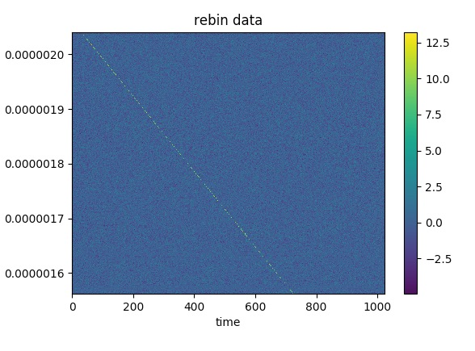
Re-bin:
DM = 350
Notes:
The real process on data is like above. the left is the simulate data with DM=350. The right is data after re-bin process.

Slide 22
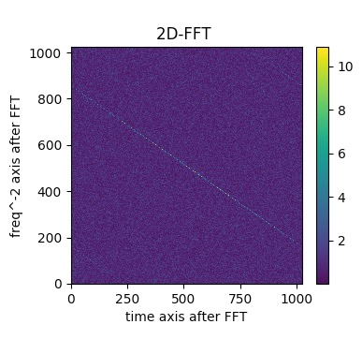
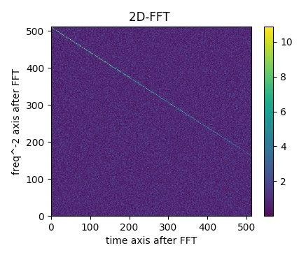
2D-FFT:
The straight line in re-bin map will become a straight line go cross center in 2D-FFT map.
Each angle present a special DM signal line .
Signal line after FFT should not appear in First and third quadrant. So we only need the 2nd or 4th quadrant data. (it's conjugate to each other.)
Notes:
Next step, we did a 2D-FFT on this map. After this. The straight line in rebin-map will apear a straight line go cross center in 2D-FFT map. We could see the line with particular angle apparently. Each angle present a special DM signal line . As the DM always bigger than 0,the signal line after FFT should not appear in First and third quadrant. So we only need the 2nd or 4th quadrant data. (it's conjugate to each other.)

Slide 23
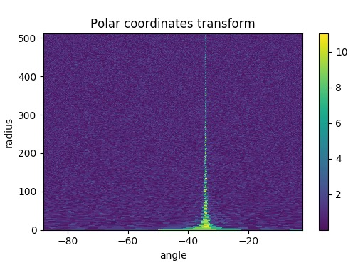
Polar coordinates Convert:
Take the center of map as original point
Calculate angle and radius length
Interpolate the data with the coordinates . Finally we can Get the polar coordinates matrix, and could plot it with angle and radius axis.
Notes:
And it's easier to locate a line only with angle and radius. So we convert the data to polar coordinates. Take the center of map as original point, and calculate angle and radius length from center point for each point. then we can interpolate the corresponding value to convert rectangular coordinates into [radius,angle] coordinates. Finally we could get the polar coordinates matrix, and could plot it with angle and radius axis.

Slide 24
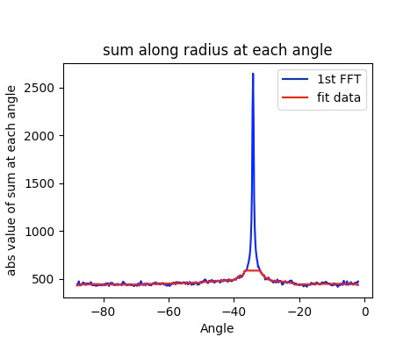
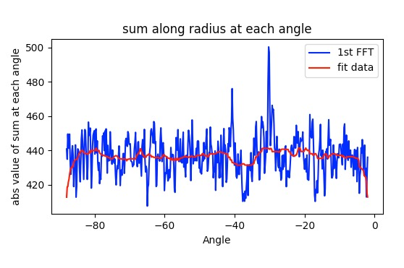
Sum it up!
Sum it up along the radius axis from -90~0 degree.
Calculate SNR.
Compare SNR with threshold
Theoretical Input SNR is 320
Theoretical Input SNR is 32
Notes:
Now we need sum it up along the radius axis from -90~0 degree. Then calculate SNR , compare the SNR to threshold.
A 2nd FFT may help to increase the SNR as Ueli-Peng suggest. The picture above is with different SNR input signal. The right SNR is 320. Left is 32.

Slide 25
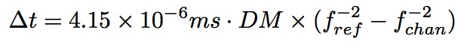
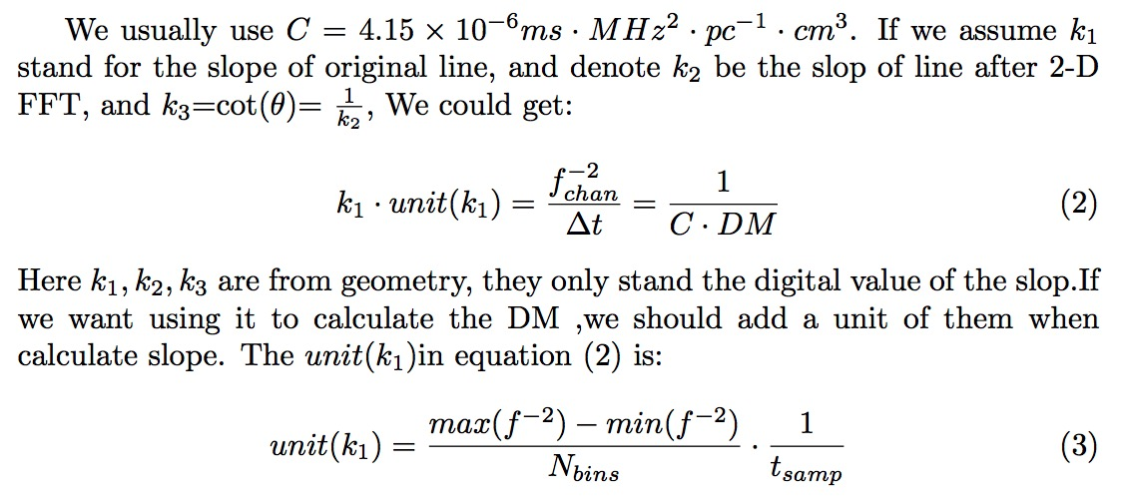
DM calculate
Notes:
As we know the relationship of time delay and frequency is: ∆t=4.15×10−6ms·DM×(f−2 −f−2 ) .

Slide 26
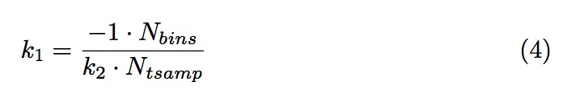
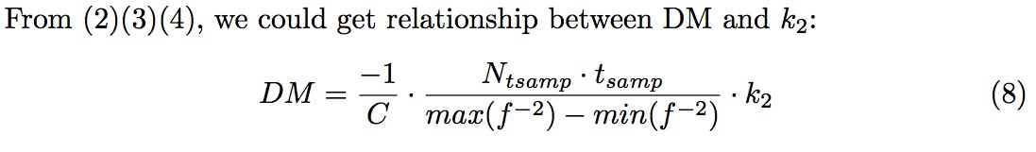
As two lines perpendicular to each other, the two slopes k₁, k₂ are also obeyed one rule:

Slide 27
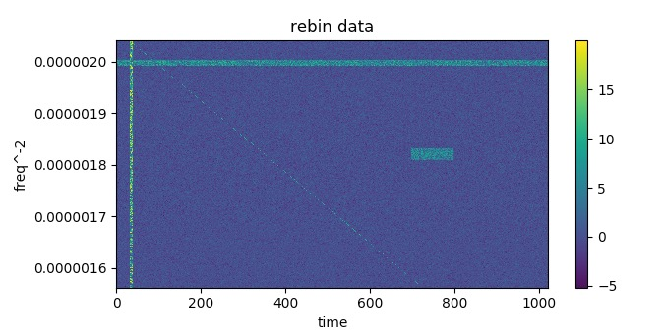
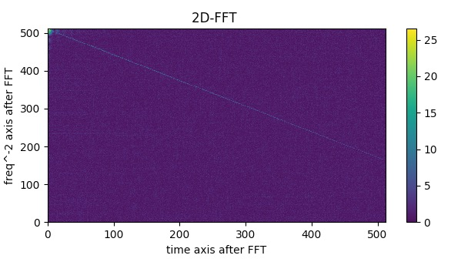
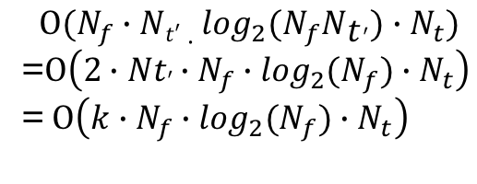
Advantage of this method:
$$Ο(N_{f}{∙Nt′∙{\log_{2}(N}_{f}Nt^{′})∙N}_{t})$$
=$Ο\left(2{∙Nt′{∙N_{f}∙\log_{2}(N}_{f})∙N}_{t}\right)$
= $Ο\left({{{k∙N}_{f}∙\log_{2}(N}_{f})∙N}_{t}\right)$
Compute complexity, this method is equal to tree algorithm
Easy to remove RFI
Easy to Parallelize (GPU)

Slide 28
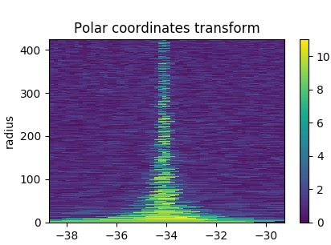
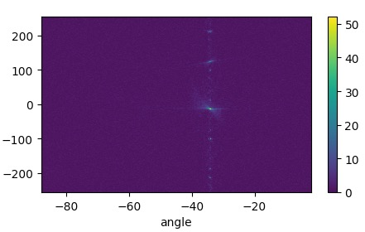
Prospect in future:
Try second 1-D FFT to improve SNR
Try 2-D FFT first then do Radon transform to search a line.
Or try Radon transform directly to search a line or curve in frequency-time map.
Notes:
This algorithm is still under developing , we might a lot problems. There are a lot of ways we can try in the future. As the signal after 2-D FFT should be a periodical signal, we can see this from left picture. Do a second 1-D FFT on radius will make the line become a point. That bring another compute burden ,however it will help a SNR improve. Some researchers in France are working on 2-D FFT first then did a Radon transform later . They have already apply this in finding flares of Jupiter . This method’s compute intensity is same as this method. Another guy in our group is working on search FRB from frequency time map directly, he is using Radon transform to do this.

Slide 29
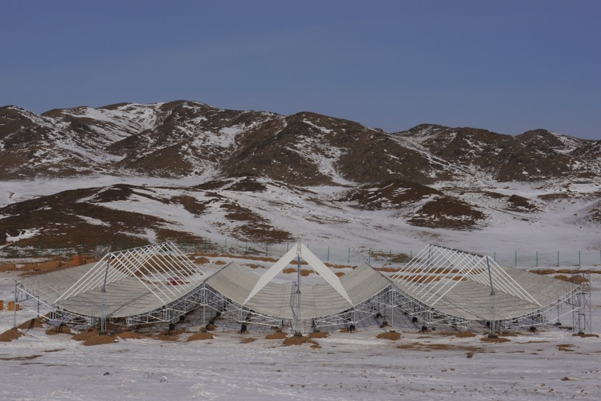
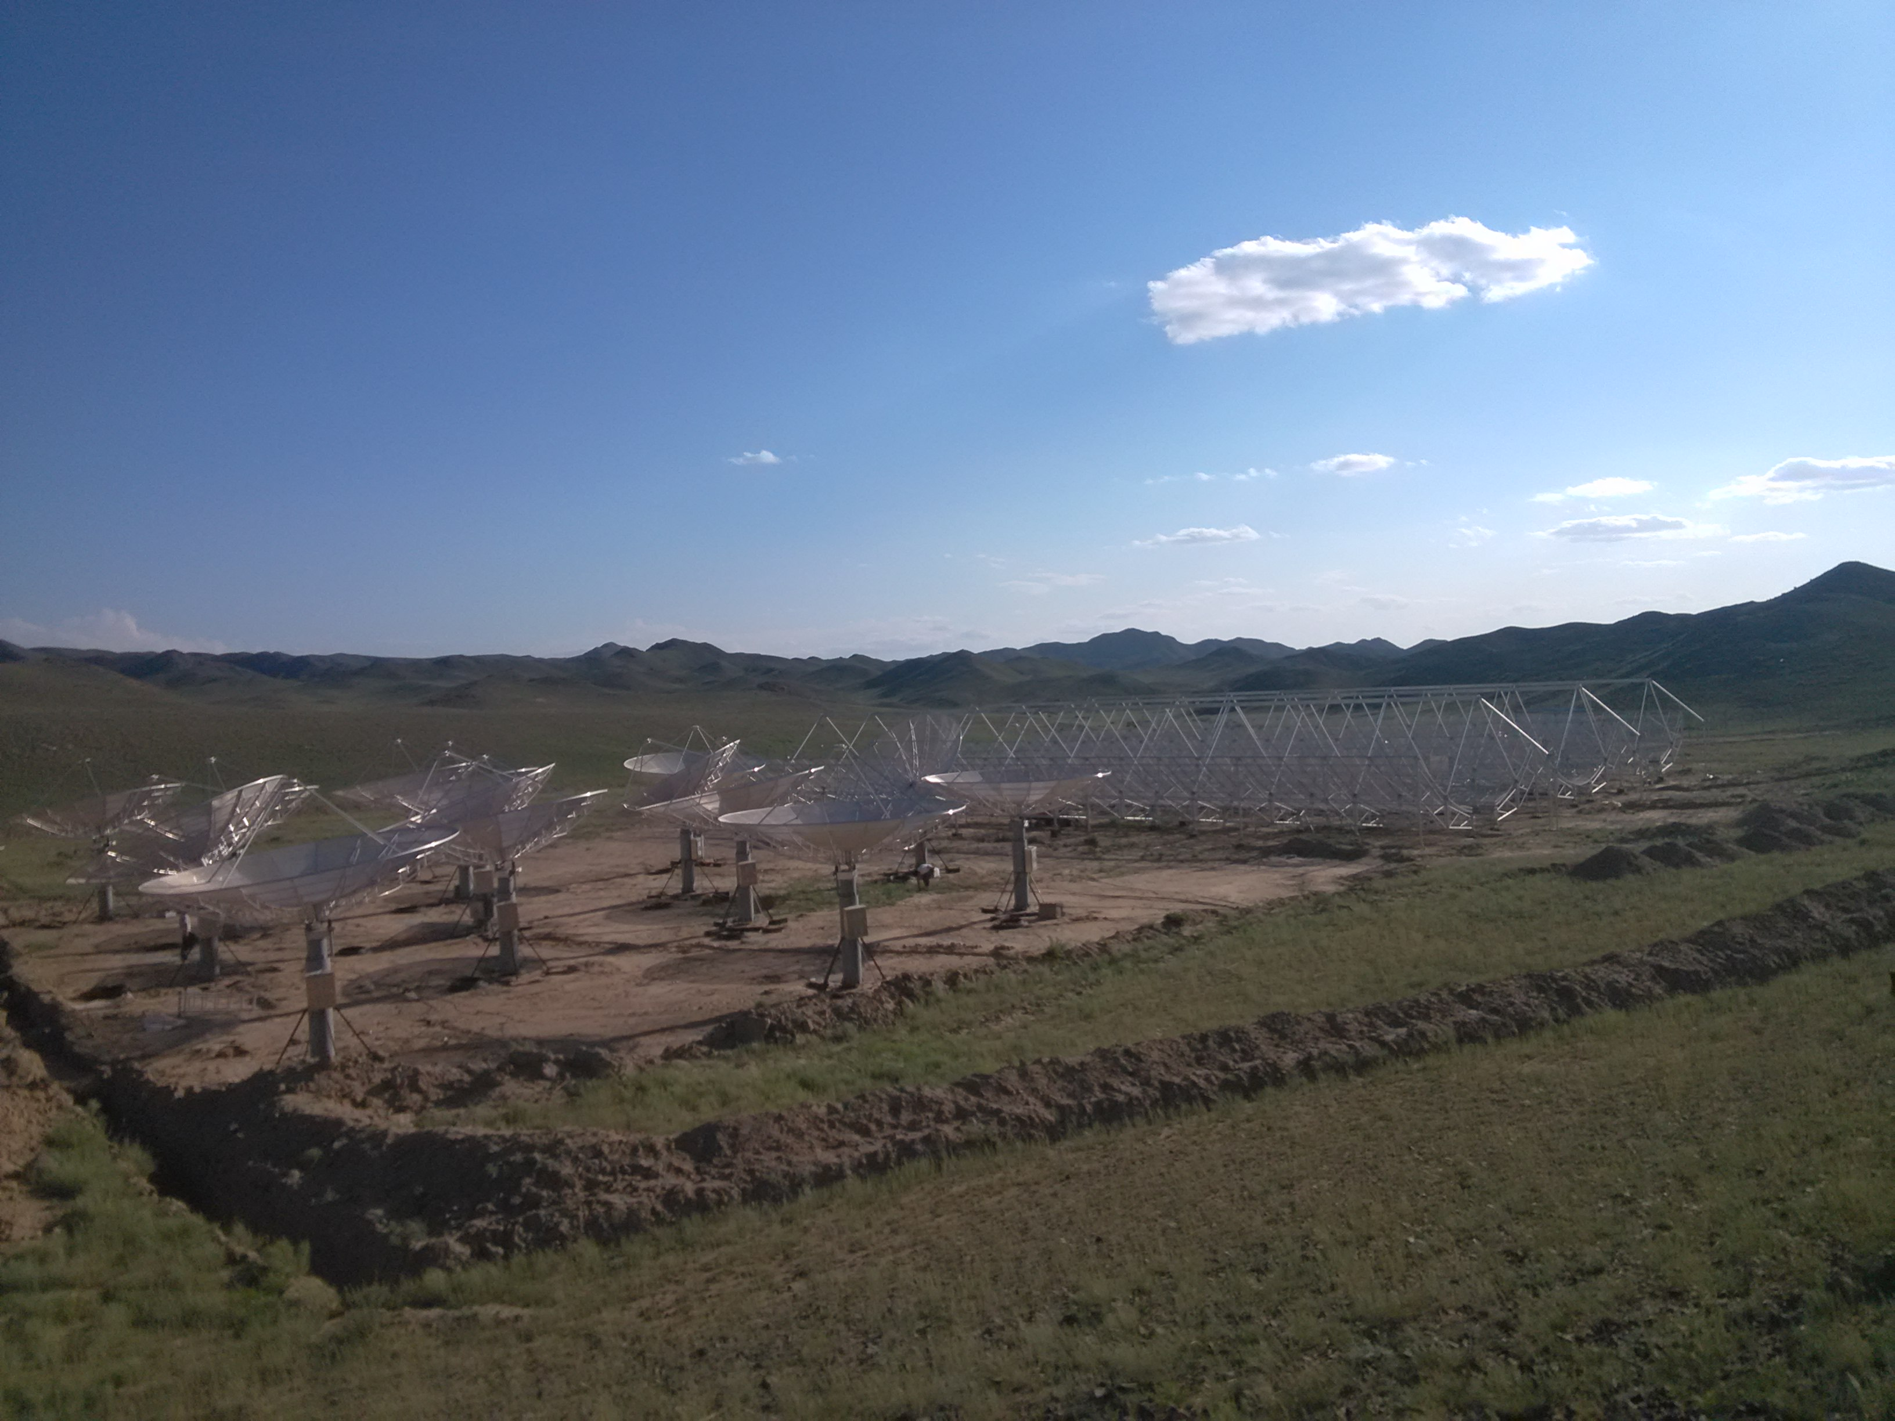
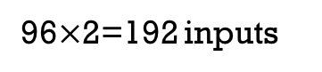
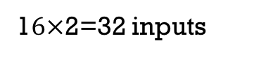
Advertisement time! Tian Lai Array!
In Xinjiang, North western China. We build 3 telescope cylinder + 16 dishes interferometer .
96$×$2=192 inputs
1$6×$2=32 inputs
Notes:
I’d like to introduce our telescopes in Xinjiang North western China, We call it Tian Lai, Chinese meaning is Song from heaven. We have 3 Cylinder, with 96 2 polar feeds, total inputs is 192. We also have 16 dishes. With 2 polarations. So total inputs is around 200 inputs. Bandpass is from 700Mhz to 800Mhz.

Slide 30
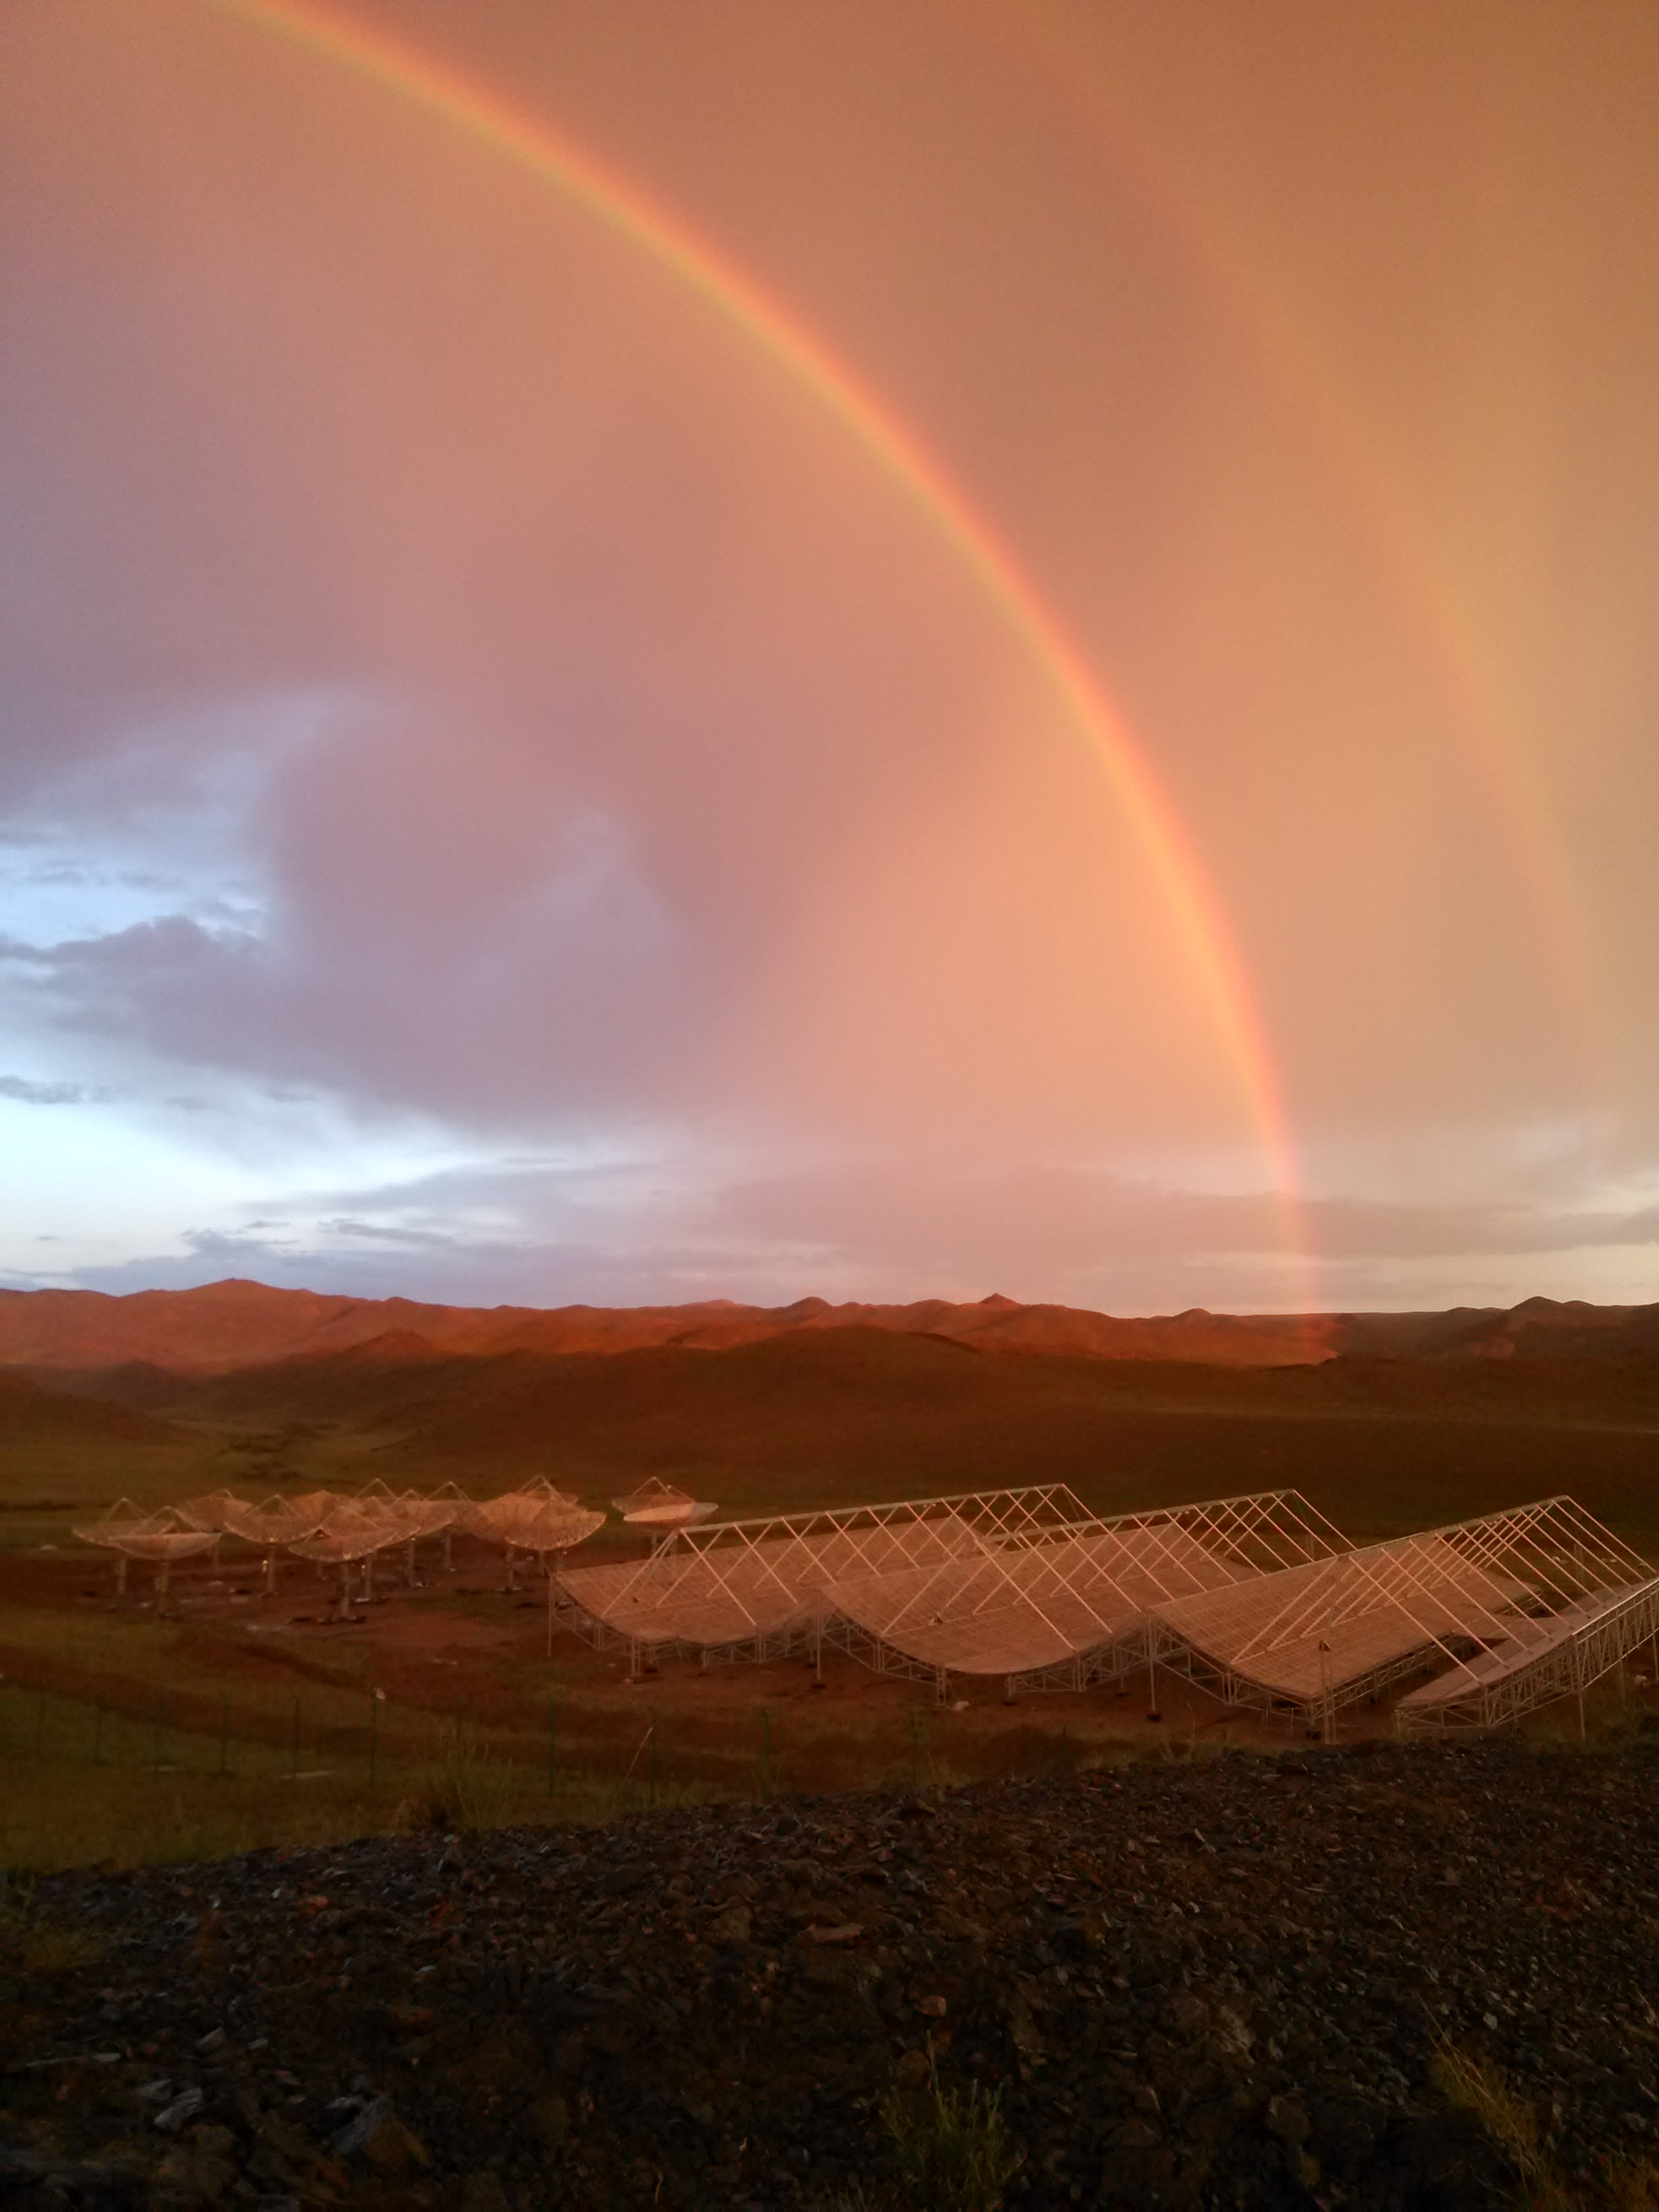
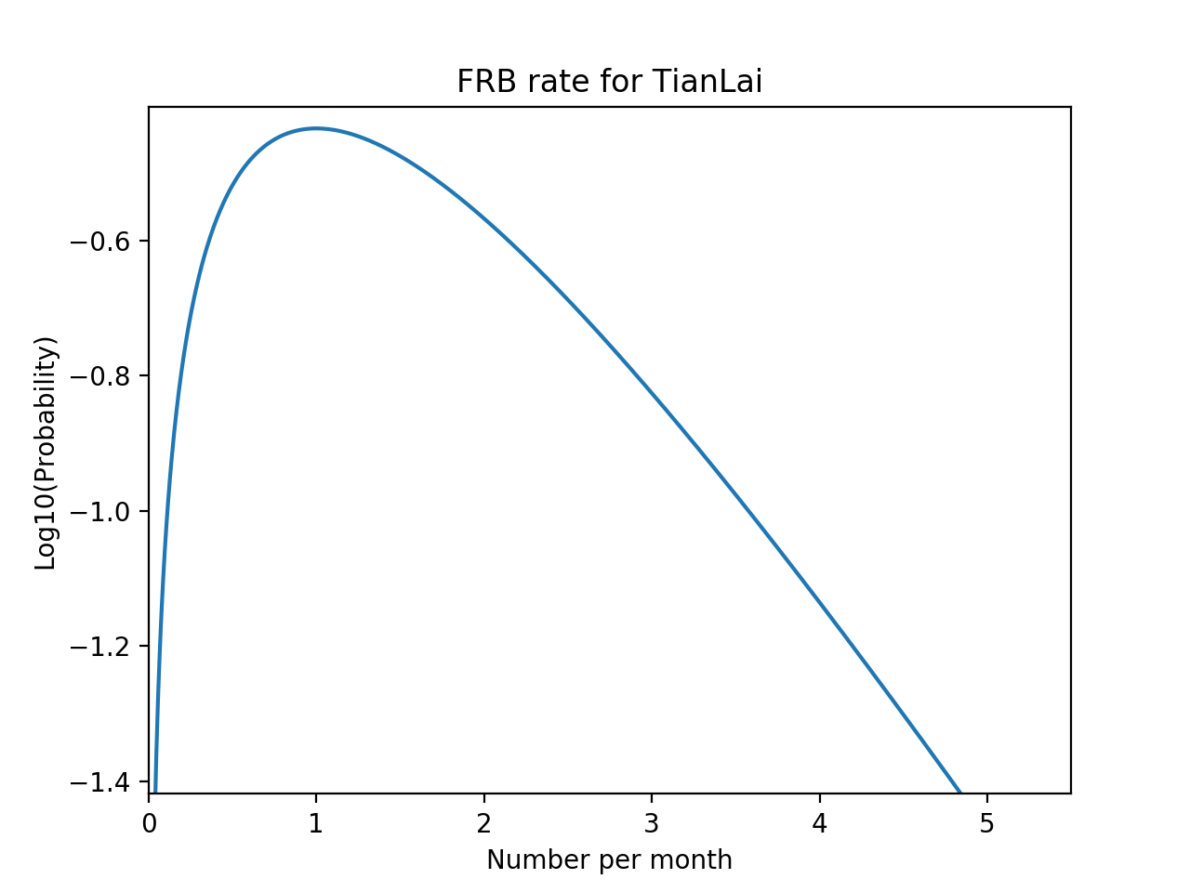
Telescope parameter for FRB
Band Width : 100MHz
Frequency: 700-800MHz
Cylinder Scale: L 40m , Diameter 15m
Dish Scale: Diameter 6 m
FOV: 160 Deg²
Time Resolution: 50ms
Beam number: 32<N<96
Above 95% confident interval, We could see
0.05~4.5 FRB Per Month!
Notes:
TianLai array are designed to observe BAO. Bandpass is from 700Mhz to 800Mhz. filed of view is 160 degree^2. we are planning to add a FRB mode. As estimate before ,Above 95% confident interval, we could observe 0.05-4.5 FRB per month. We are plan use FFT method to create multibeam.

Slide 31
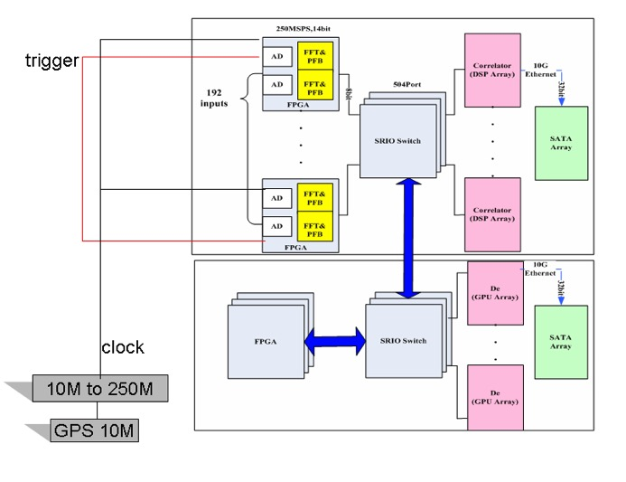


Digital backend(plan)
Already have
Using SRIO to make a data copy.
Beamforming by FPGA(GD2FPGA designed by IACAS).
De-dispersion are processed by GPU Array.
High speed SRIO switch.
GPU server SRIO NIC
FRB search
GD2FPGA
GPU server NIC
SRIO Switch
Notes:
The correlator system that we already have, (designed by Institute of Automation，Chinese Academy of Sciences) We plan to increase a FRB system , using SRIO to make a data copy. Beamforming are designed to implement by FPGA(GD2FPGA designed by IACAS). De-dispersion part are processed by GPU Array.
Between FPGAs and GPU server we plan to use high speed SRIO switch.

Slide 32
Thank you!
Notes:
Wellcom to visit our telescop or keep concentrating on it. Thanks!

